Slide 1

Searchable encryption
Ostepoc Lucian
Nicu Andrei
Grigorita Mihai-Adrian
Tanase Bianca
http://www.amichalas.com/blog/

Slide 2
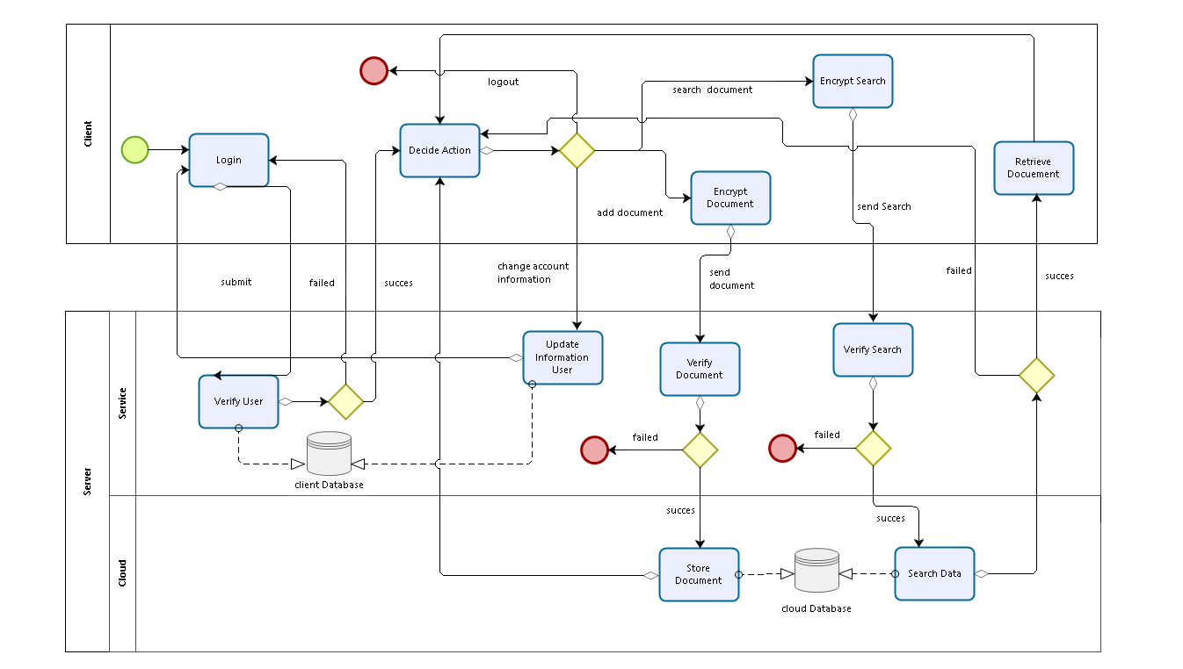
BPMN

Slide 3
AOP C# Command
ICommand interface;
Command class which implements ICommand;
LoggingBehavior:IInterceptionBehavior interceptor for our interface.

Slide 4
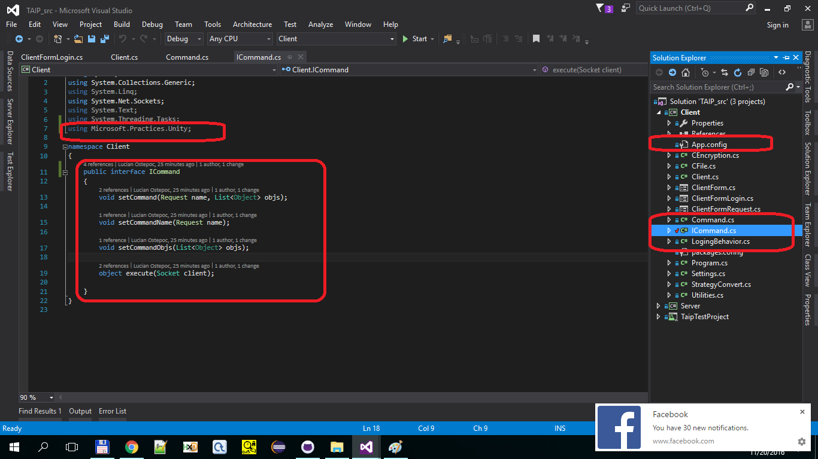

Slide 5
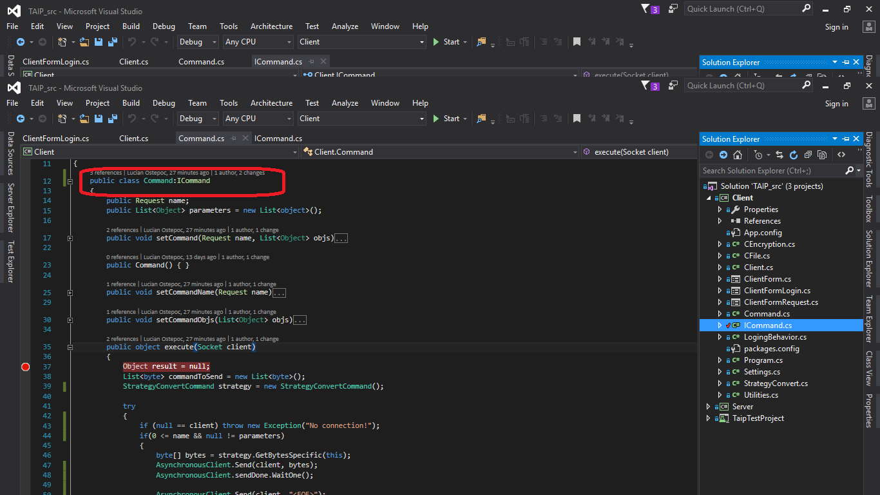

Slide 6
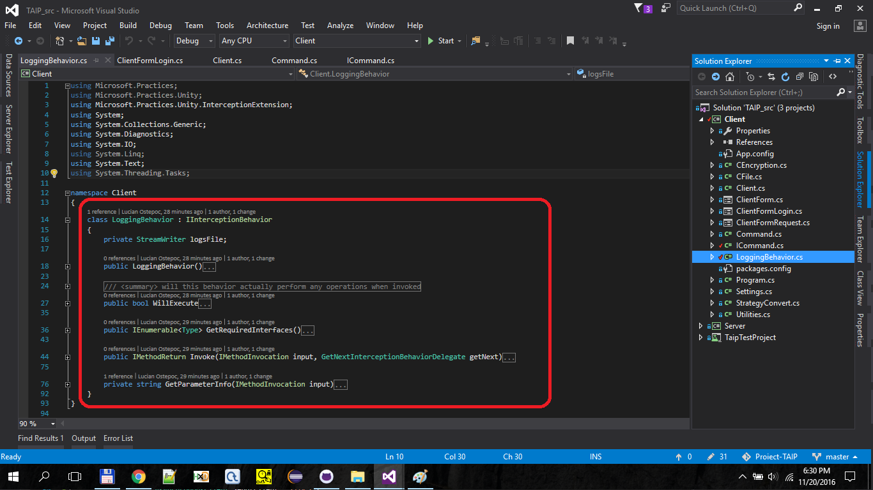

Slide 7
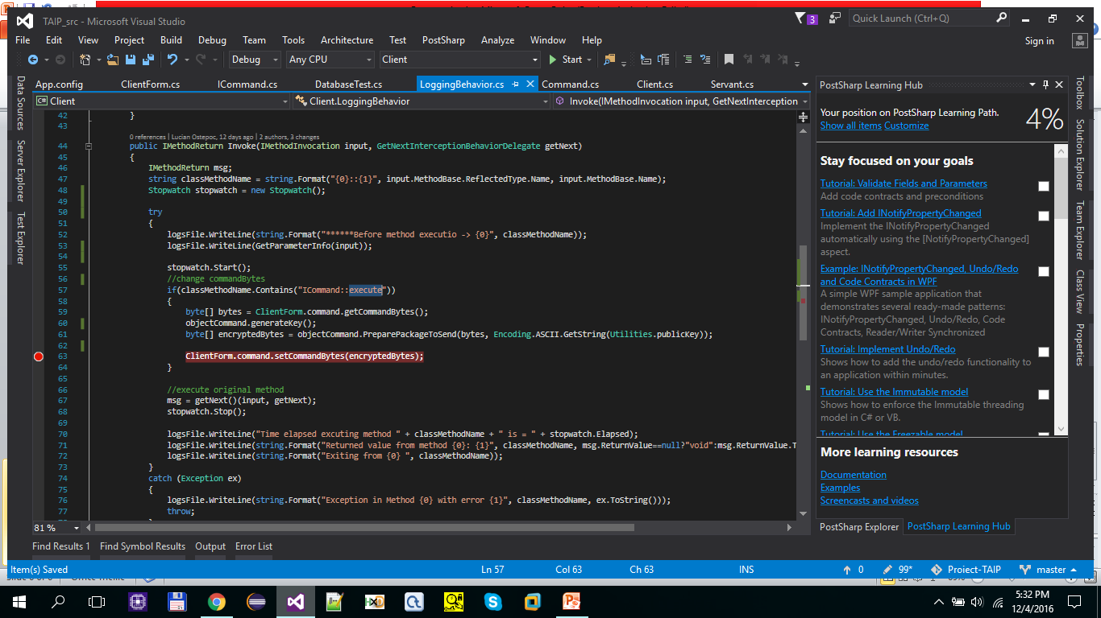

Slide 8
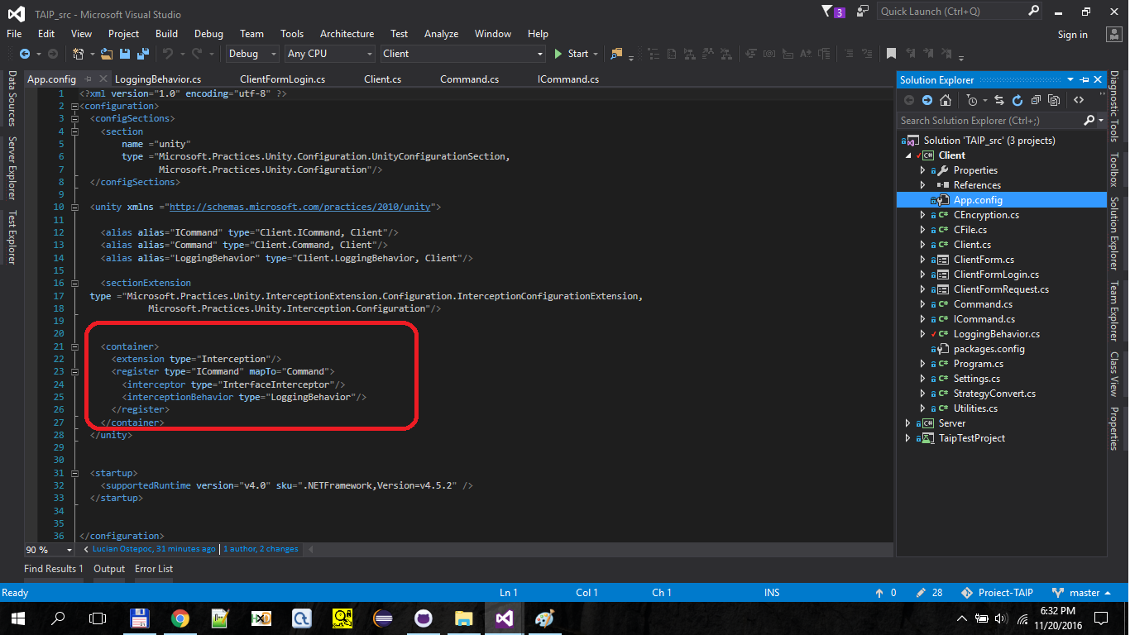

Slide 9
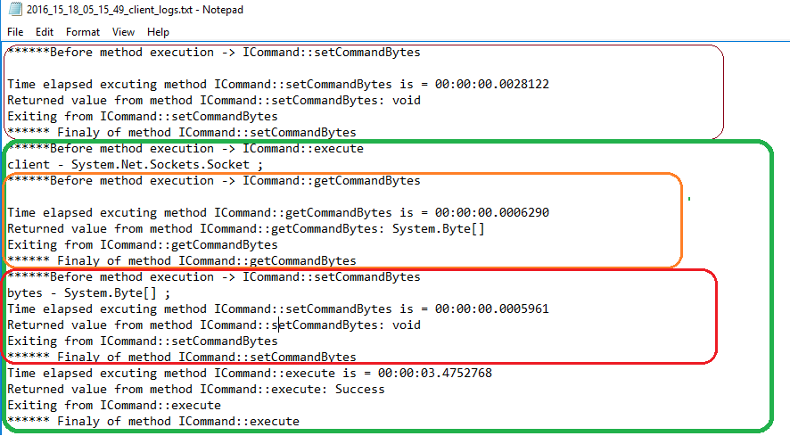

Slide 10
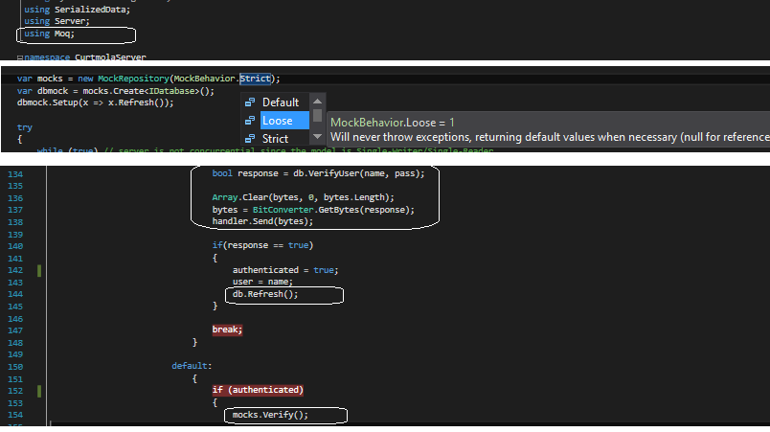
Moq C#

